Slide 1
Discharge Analgesia Template for EDS
For questions, contact: champika.pattullo@health.qld.gov.au Champika Pattullo (QUM Pharmacist, HIU Fellow)
Voiceover by Benita Suckling

Slide 2
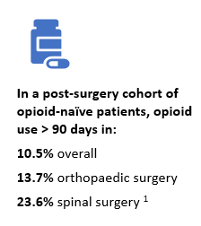
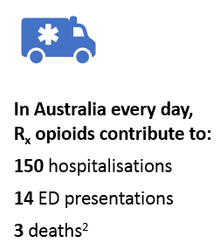
Opioids, Pain Management & Handover
Known high-risk medications
Transition of care potential for miscommunication
Can potentiate long-term use and harm
In many cases, expectation for GP to review and manage pain after hospital encounter
You can help by providing timely and complete handover
Stark N, Kerr S, Stevens J. Prevalence and Predictors of Persistent Post-Surgical Opioid Use: A Prospective Observational Cohort Study. Anaesthesia and Intensive Care. 2017;45(6):700-706.
Australian Institute of Health and Welfare. Opioid harm in Australia and comparisons between Australia and Canada. Canberra: Australian Institute of Health and Welfare; 2018. Available from: <https://www.aihw.gov.au/reports/illicit-use-of-drugs/opioid-harm-in-australia/contents/summary>
Notes:
Opioids are known to be a high-risk class of medication and there is a potential for miscommunication about their management at transitions of care. This could result continuation or cessation when this was not the intention.
Research has shown that, depending on the surgery, more than 10% of opioid naïve patients started on opioids after surgery go on to use opioids longer-term. This contributes to the many unintended harms, and substantial opioid reservoir we’re becoming aware of in Australia.
In many cases, the expectation might be for the GP to review and manage pain after a hospital encounter, and to do that effectively and avoid unintentional long-term use for your patient, the GP needs you to provide a handover about the opioid that’s been prescribed, the dose, duration and any plans for reduction. At present, seems to happen less than half the time.
Providing good handover to the GP is one way you can practice opioid stewardship, and keep your patients and community safer while ensuring good pain management.

Slide 3
Junior Medical Staff
When discussing audit results with junior medical staff, they suggested an accessible template would be a helpful tool to improve practice

Slide 4
To Assist – Discharge Analgesia Template
Streamline the process of providing a more complete handover of analgesia and opioid management; presently targeted for post-surgery

Slide 5
*Test Patient* – EDS Demonstration
On Management Plan tab, click on green + to add “Recommendation to GP”
On the add new recommendation popup – click on “Insert standard content” select Opioids from the list (or ‘#OPIOIDS’*).
Preview and edit text as required – accept and save.
*(Yes, we fixed the ‘opioid’ spelling for the final version)

Slide 6
Use & Evaluation
Where possible, please ensure notes entered in this fashion match other advice -
Prescription
Pharmacist-generated list (eLMS)
Feedback on this functionality is welcome!
If problems encountered, please escalate with an incident report or as appropriate
Uptake and how advice matches to other documentation should be monitored within sites, ideally as part of general QI cycle

Slide 7
Thank you!

